Slide 1

Introduction to Level Design and Game Asset Creation
CIS5014 Port 1
By Rhys Allen

Slide 2
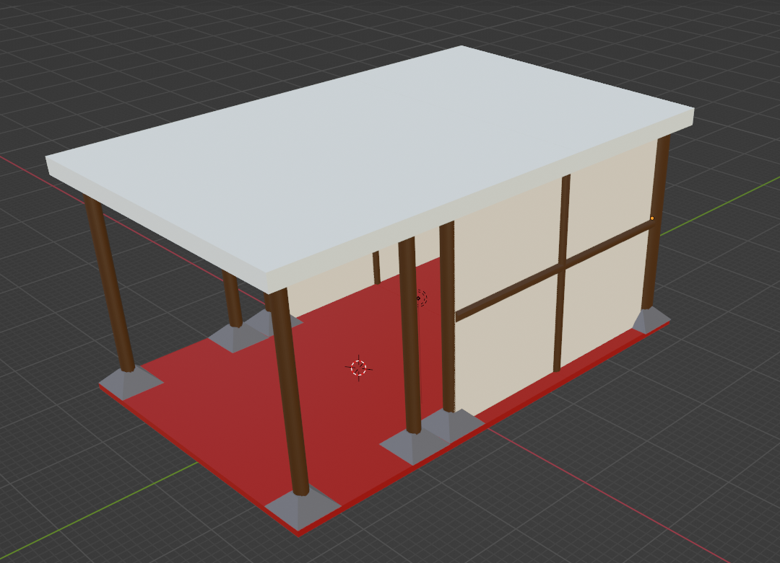
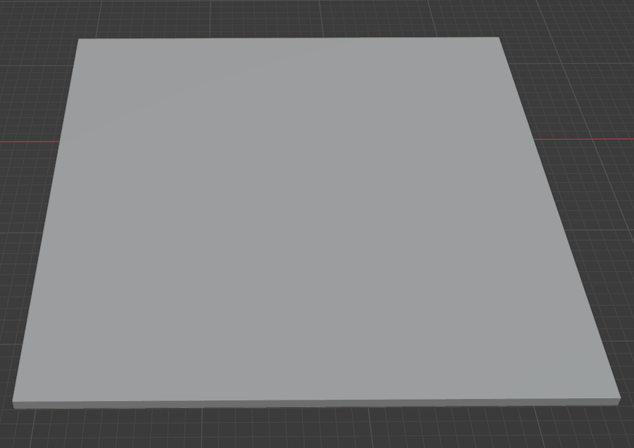
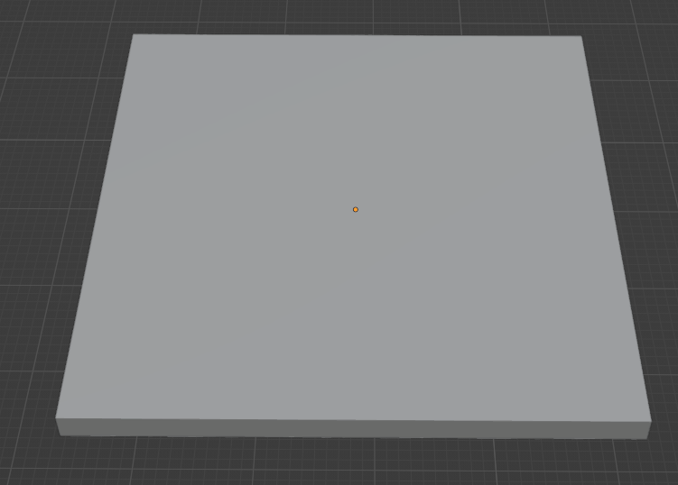
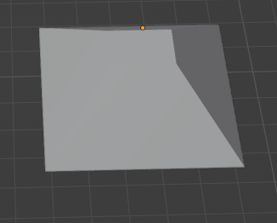
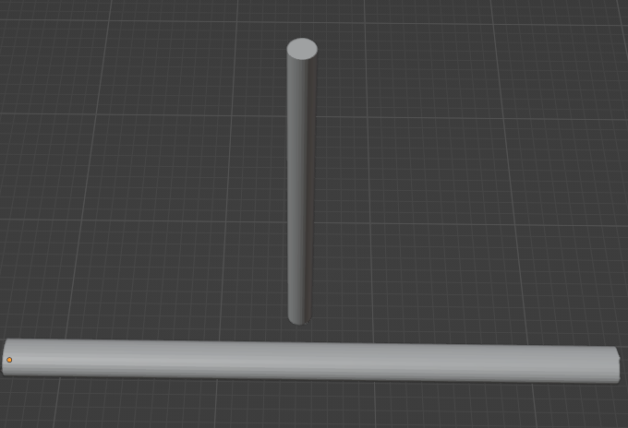
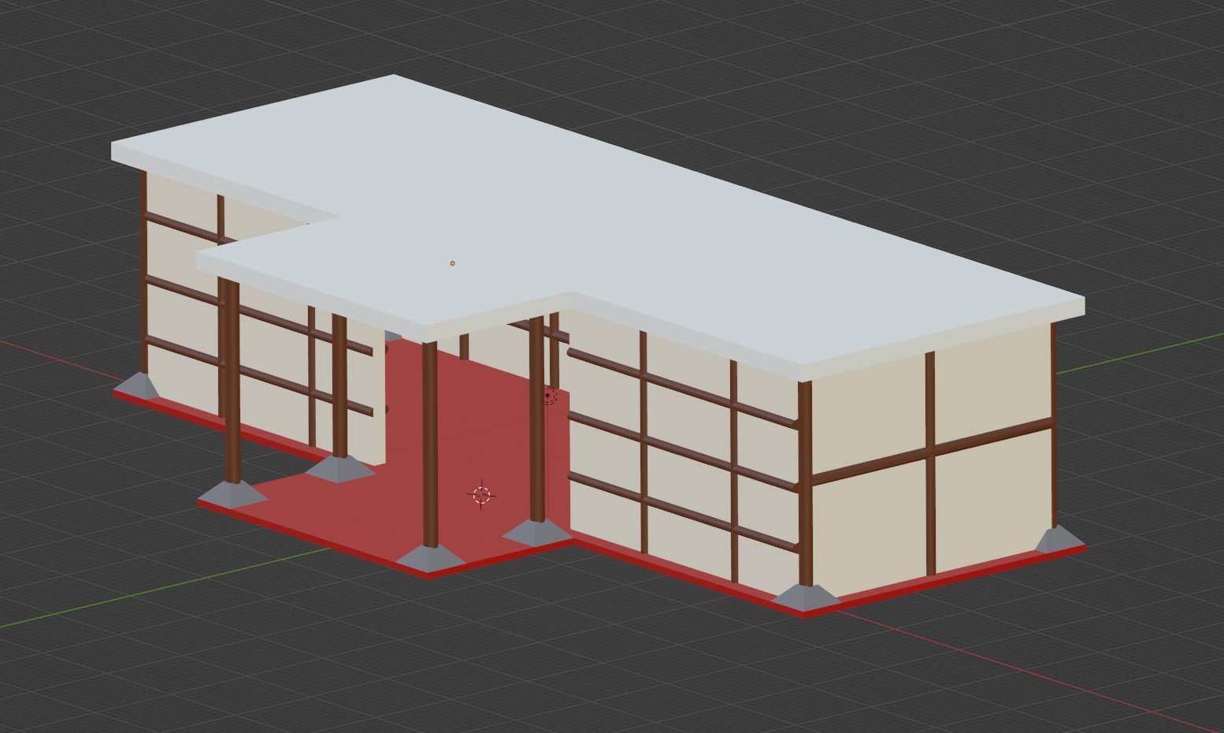
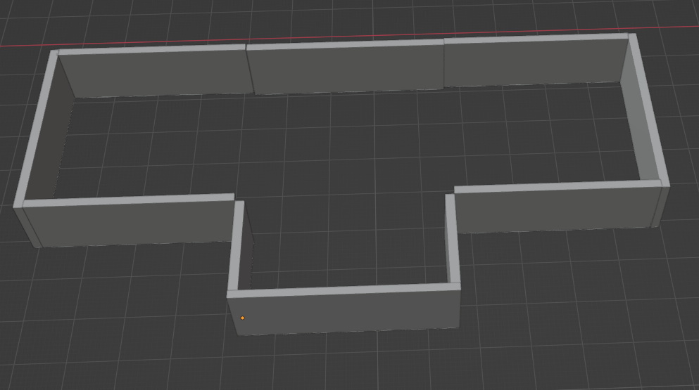
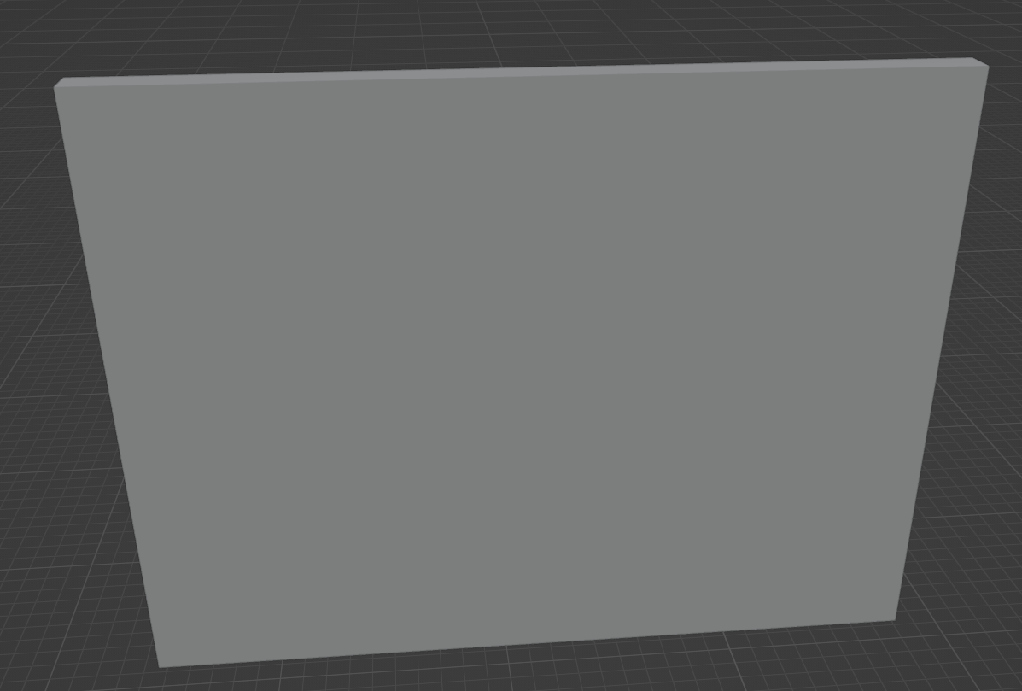
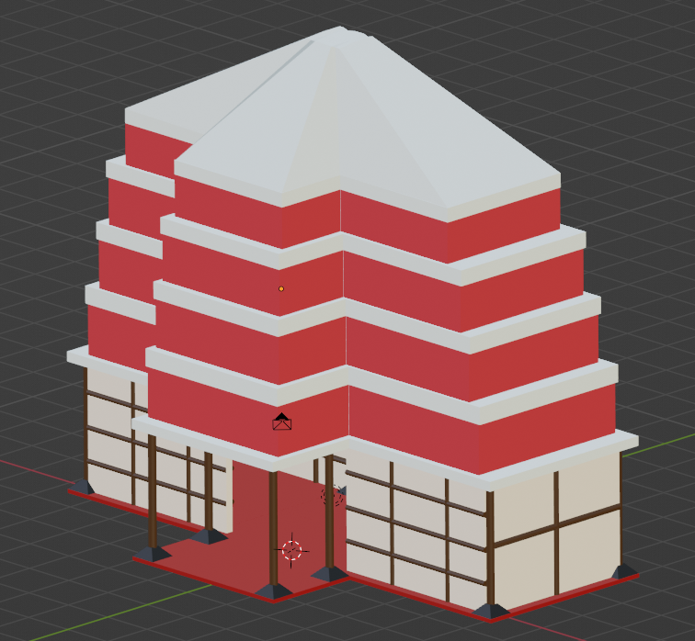
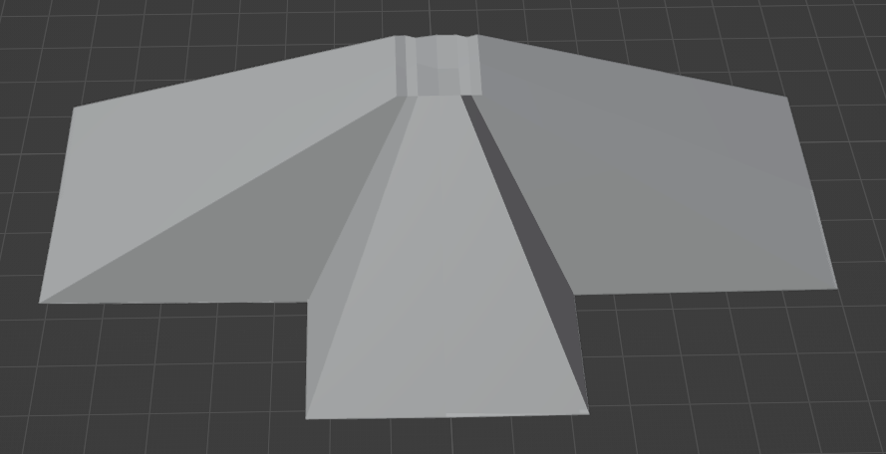
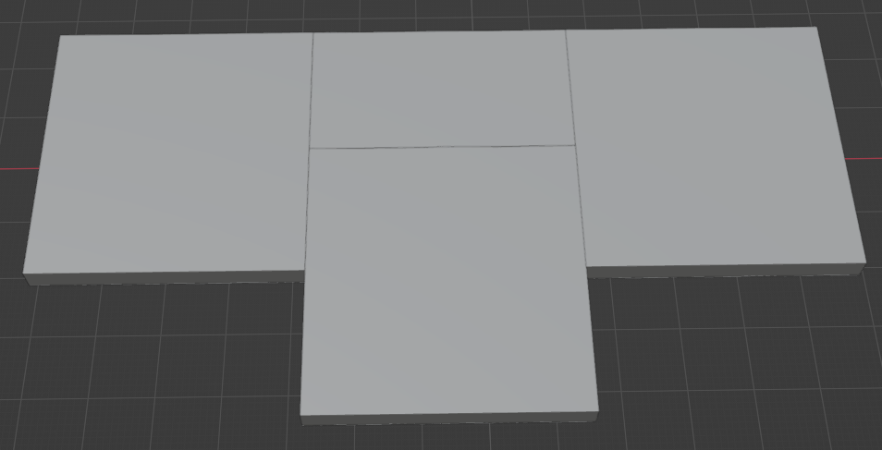
3D Modelling: Building
This is the first evolution of the building, Based on middle ages, Asian architecture. I used a bases of cubes to create floor, walls, roof and support bases. Then using a cylinder, I made wooden support beams to hold up the roof and reinforce the walks to add some texture to the bland walls
The creation process:
All objects you seen are the bones of the buildings and its evolutions. The floors, roofs and walls are made from cubes that were flatten, the reinforcement poles are cylinders; one of which is more flattened to give it a sharper look and the other rounder. The two unique sections are the upper walls Which is made from many thin cubes to fight the unique shape of the roof
646 poly
This is the second evolution of the building, using the same objects and patterns to expand the first hut with two new rooms, Adding more support beams on the front and back give it some contrast from the other parts of the buildings
1306 poly
This is the third iteration of the building, Its gained upper floors and a proper roof. A descending pattern up matches the architecture of the middle-aged Asia. The roof was created by making a thick base with a thin wall above and continuing on that pattern until the roof
And the roof which was a cuboid that was cute using loop cut and extend the new cuts upwards to make the roof tip
1682 poly

Slide 3
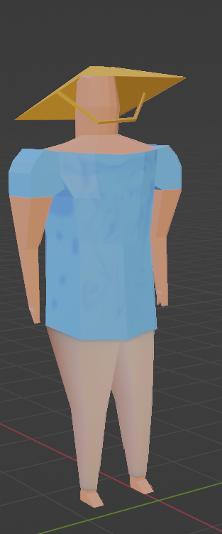
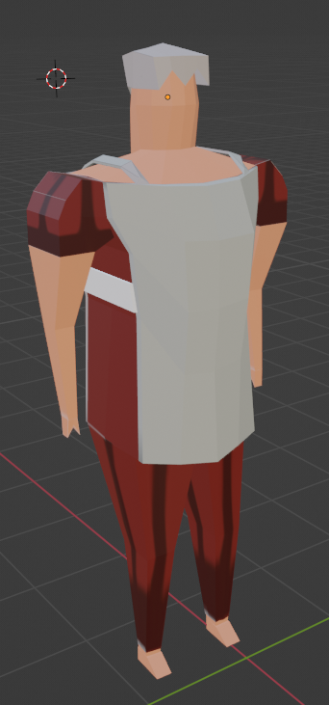
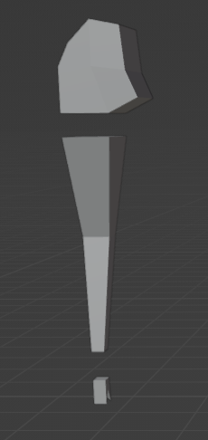
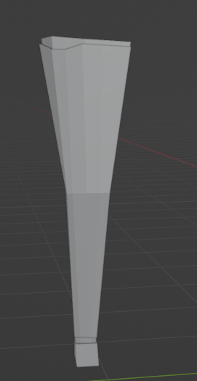
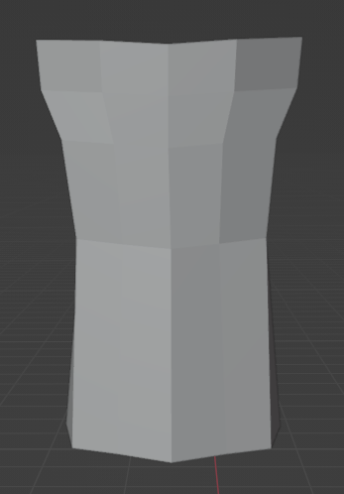
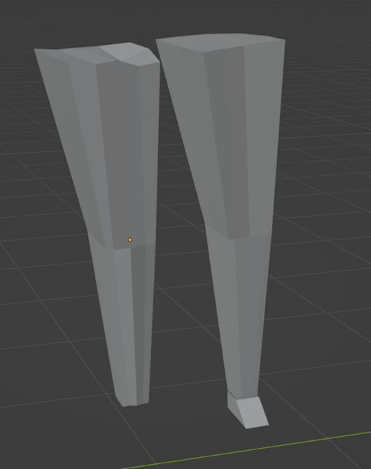
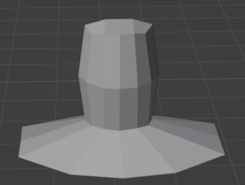
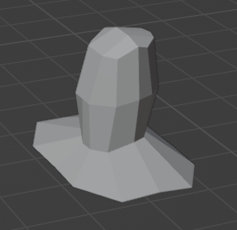
3D Modelling: NPC’s
These are the two NPC models I made for the game. The first one is based on a farmer around the same period as the building and the second is a guard with colours that match the building. Both models were made with the same body which is separated into; Body, Shoulders, Arms, Legs, hands, Feet, Head. Each of them feature entity’s other than their body. The farmer has a hat, and the guard has armour which as you can see is external from there body.
The creation process:
The arms and legs consist of multiple models put into one area. The leg features a trouser/ Pants that go over the actual leg to give it some depth. The arm is made from a shoulder, arm and hand. The decision was made to make animation easier to be able to separate the objects can give more flexibility on how the model will animate
427 poly
568 poly

Slide 4
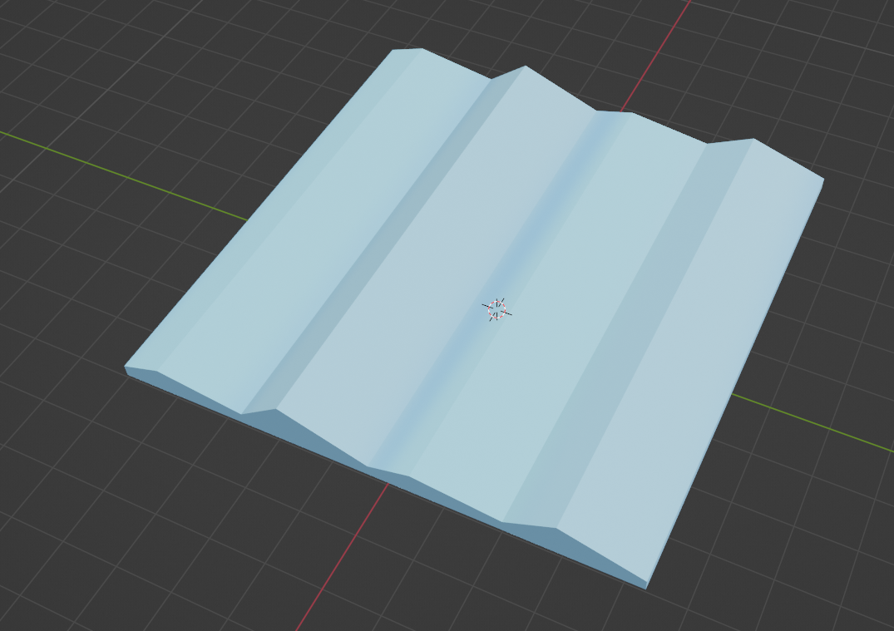
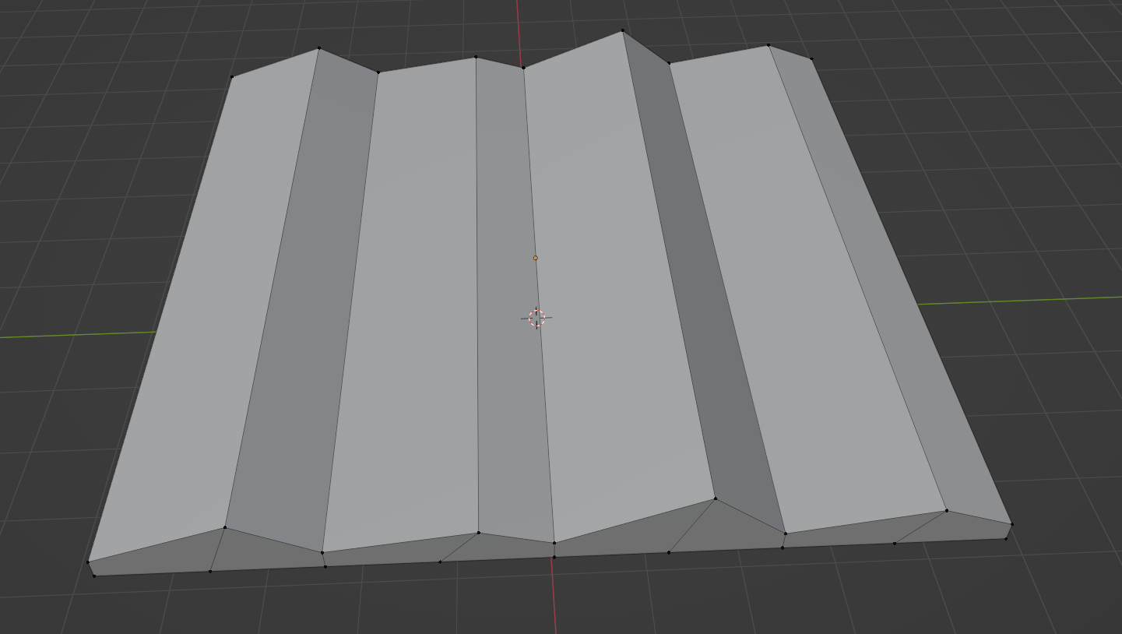
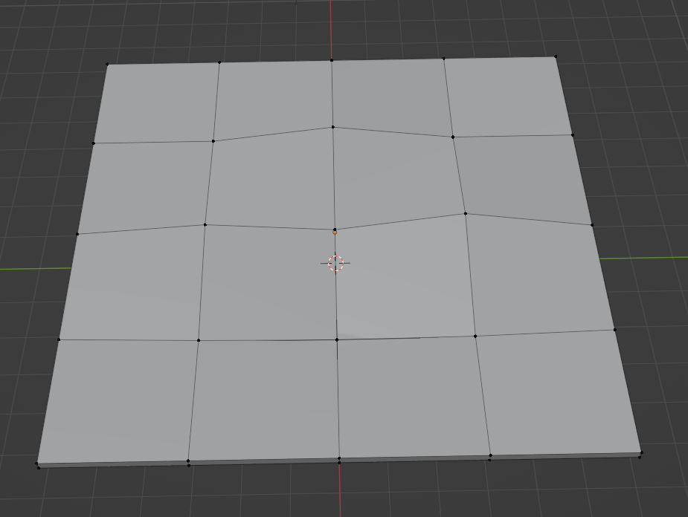
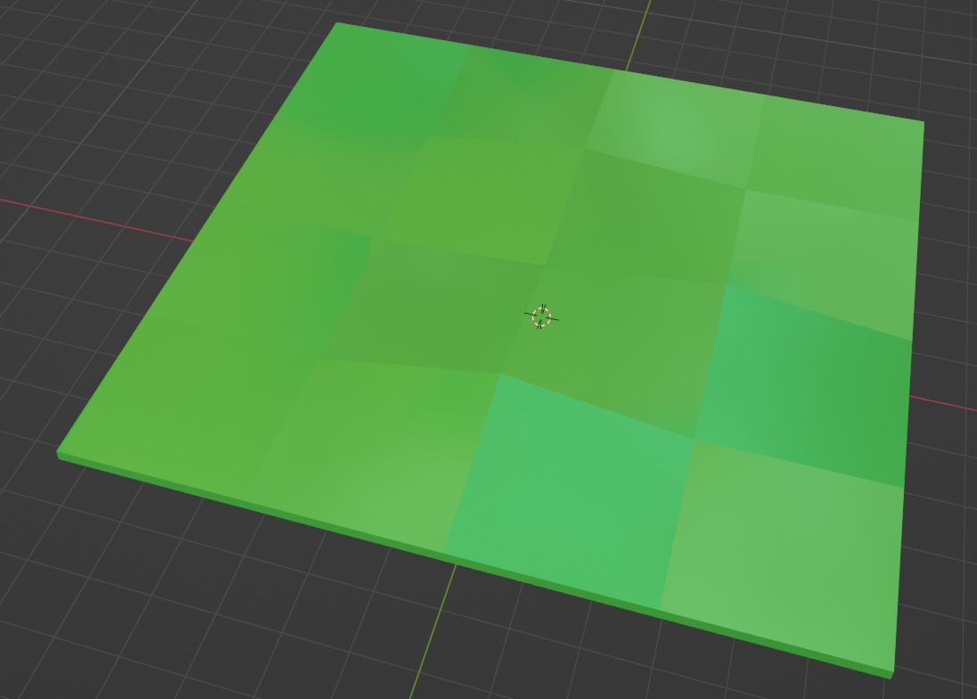
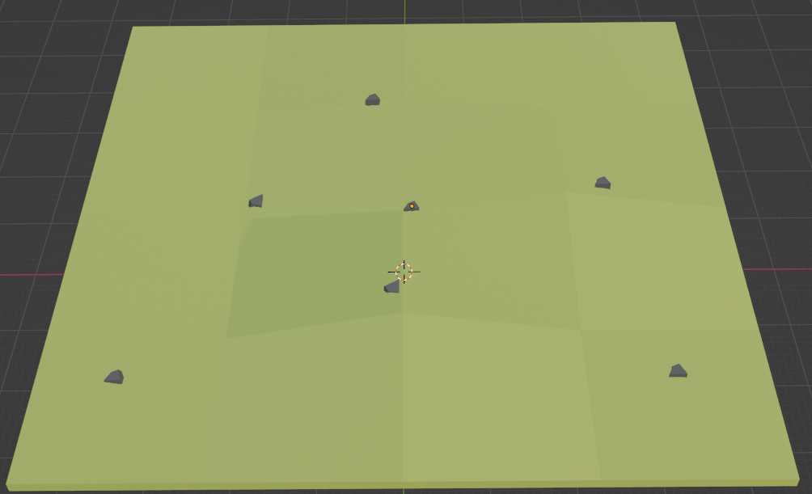
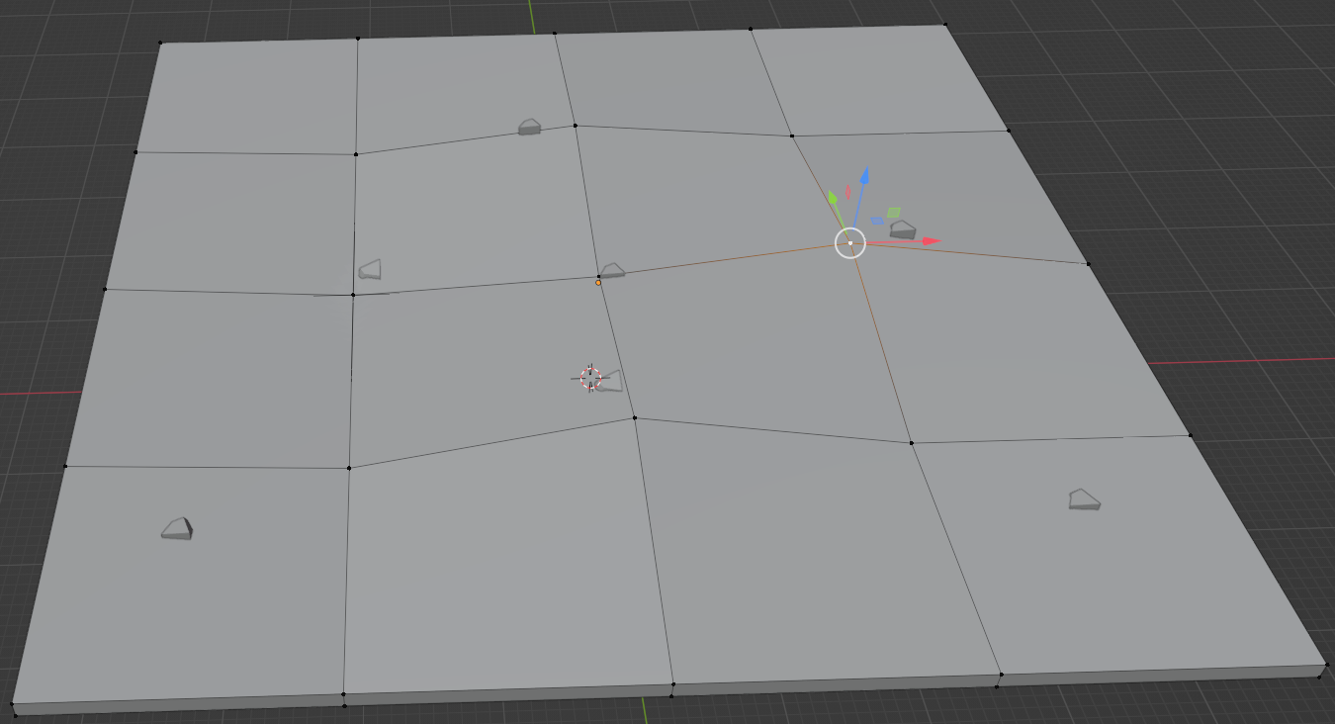
3D Modelling: Terrain
These are the 3 terrains, The first is water, the second is grass and the last is a savannah terrain. Water acts a blockade for where the player wants to build, grass acts as a terrain the player can raise or lower to expand their building and savannah is the same as the grass terrain. These are made from a cube which has been flattened and been cut to add rivets and bumps to give it texture. The savannah is unique where it has pebbles to give it more texture
36 poly
48 poly
90 poly

Slide 5
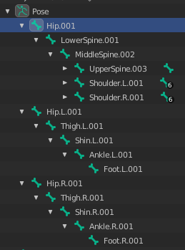
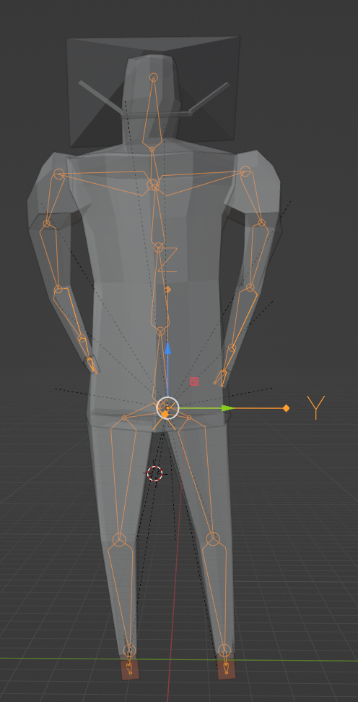
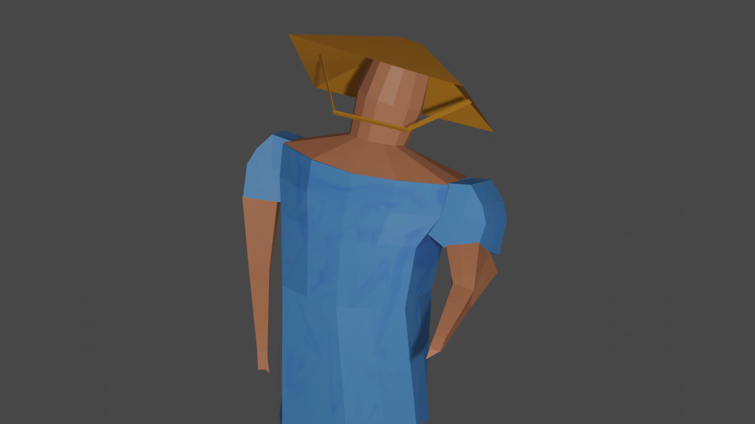
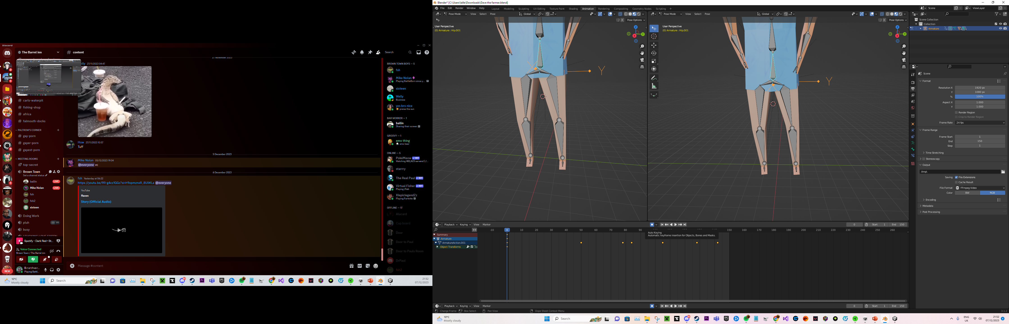
Animation: Rig and Animation
As you can see, The rig system, The actual rig and a short animation are displayed on the side. This rig or called a “Skeleton” is used on the farmer model and he was animated to look around to show the basic understanding of animation. Using creates a key frame each time Skeleton is moved, allowing for easier animation.
The rig was made from the left first, all models were made on the left then named ___.L.___ . This follows blenders naming conventions and allows for the use of “Symmetry” Which will make a duplicate of one side to the other, Running along the spine which runs central to both

Slide 6
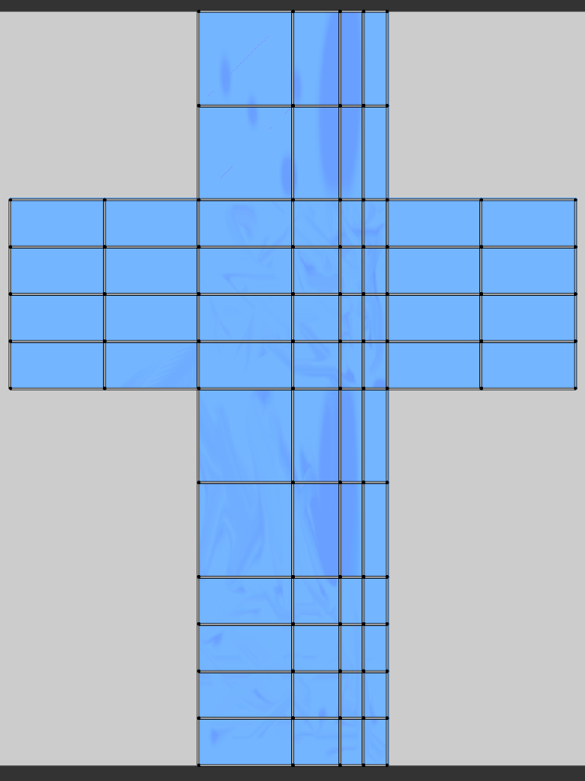
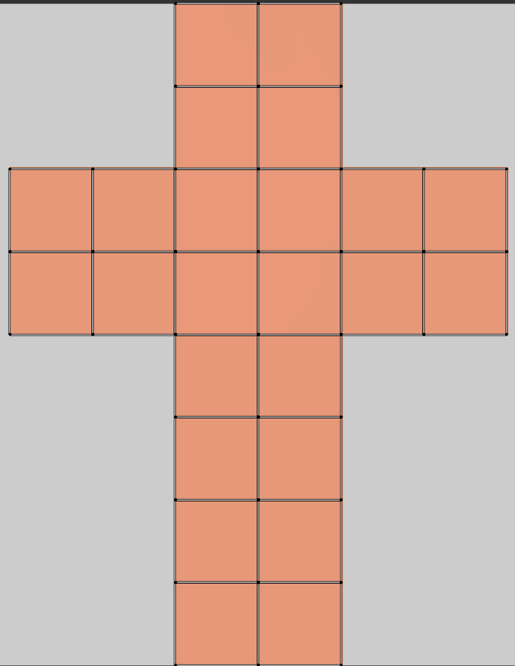
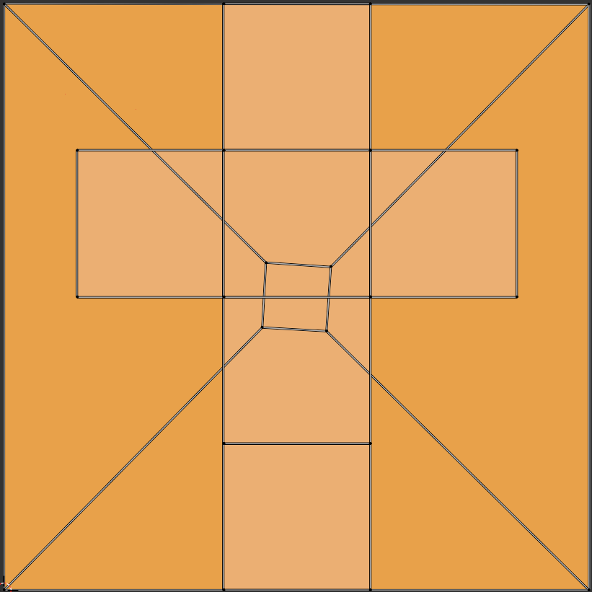
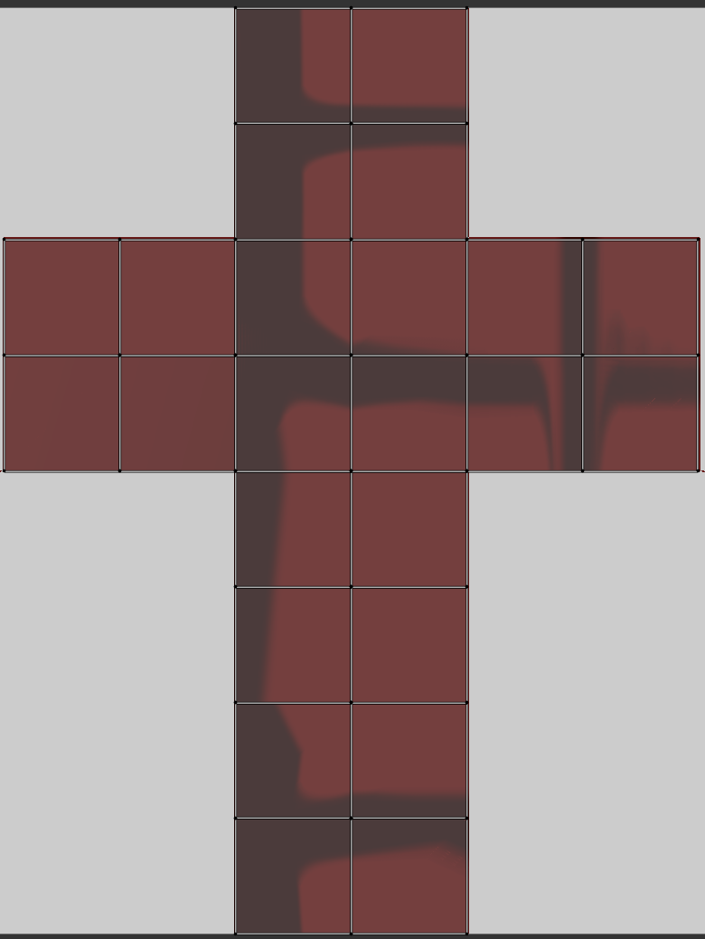
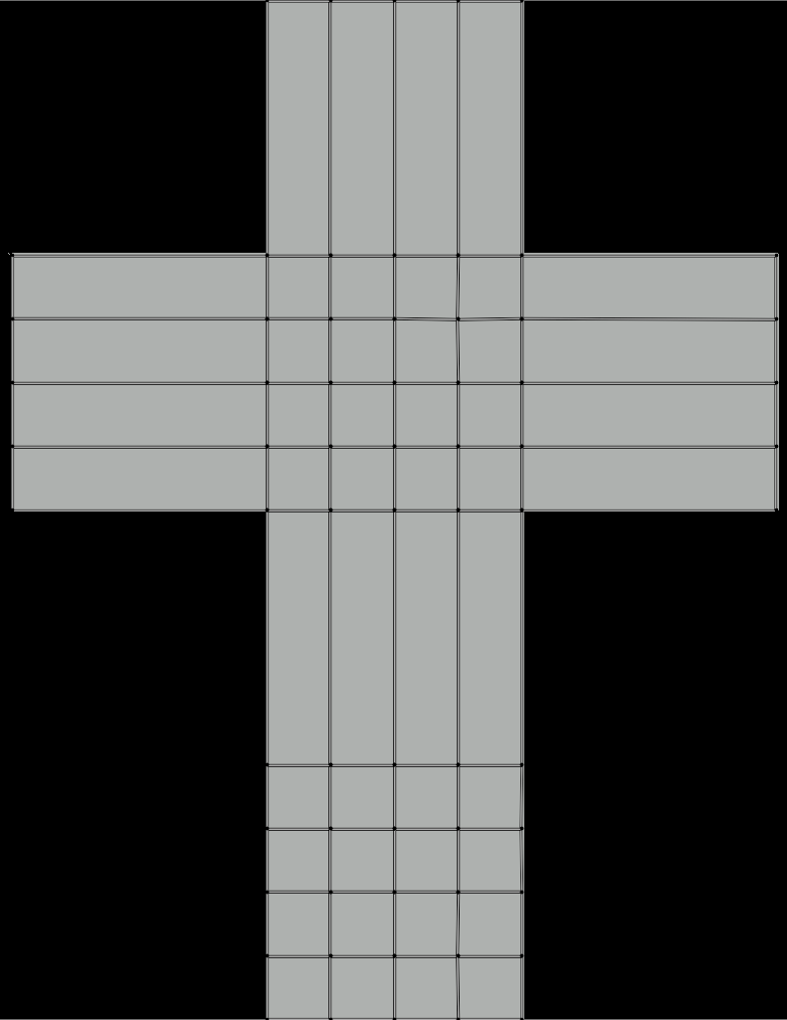
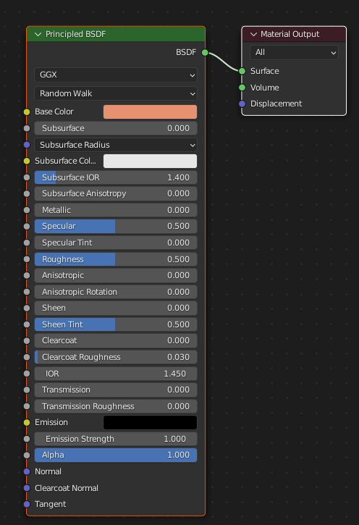

Textures: Npc’s
The Farmers T-shirt
The Farmers skin
The Farmers hat
The Soldiers shoulder, T-shirt
and leg patterns
The helmet, armour front and back
The Farmers Trousers
The textures for the farmer are basic, but effective. The T-shirt is blue with random blemishes to show that the farmer works and it’s to emulate sweat. The trousers are unique in the fact that they have no texture map. It’s a basic colour that’s been added to the model then as shown it been given affects to make the backside get darker nearer the body, to show sweat
These are all the textures for the soldier. There nothing unique about the soldier other than the unique pattern on the cloths
The Soldiers skin
The Soldiers armour braces

Slide 7
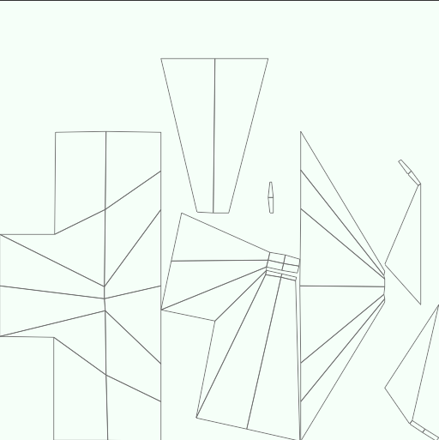
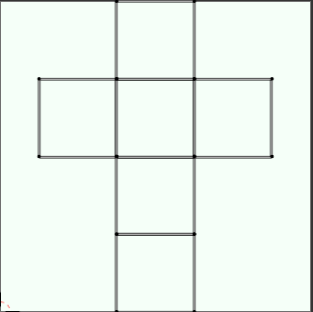
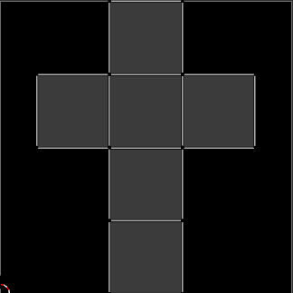
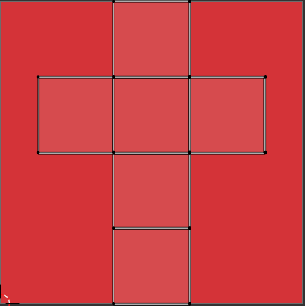
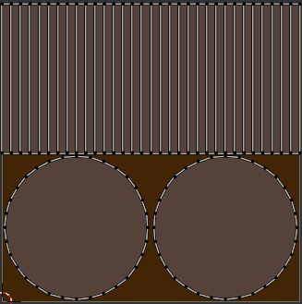
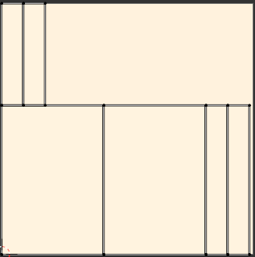
Textures: Buildings
The textures for the building aren’t anything complicated, but pairing the colour scheme and design it give an accurate representation of a simplified version of the buildings in the area they are based on
The roof texture
The upper floor texture
The Support base texture
The floor and upper walls texture
The Support beam texture
The lower walls texture

Slide 8
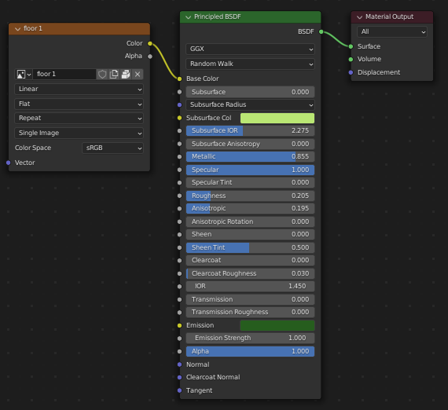
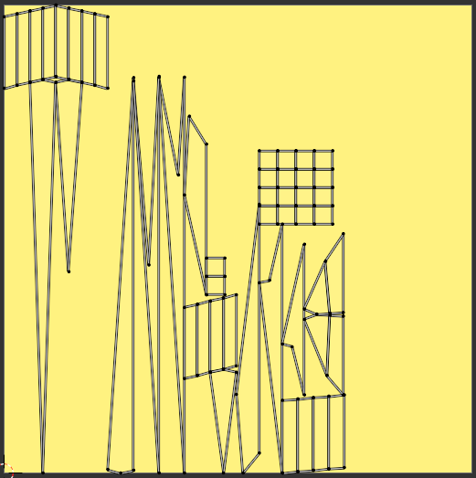
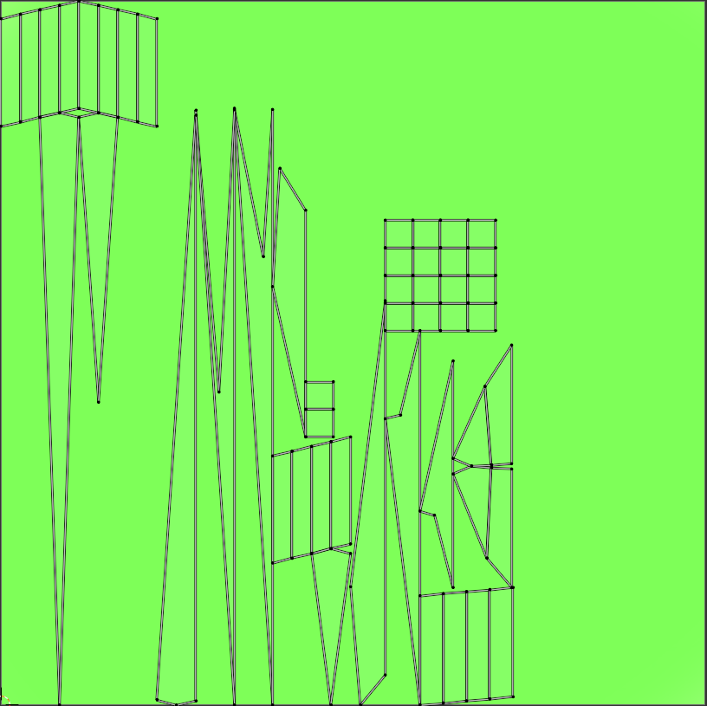
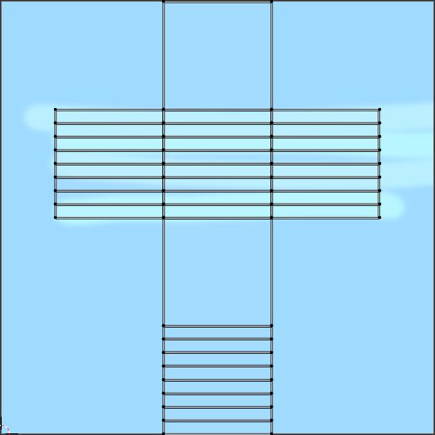
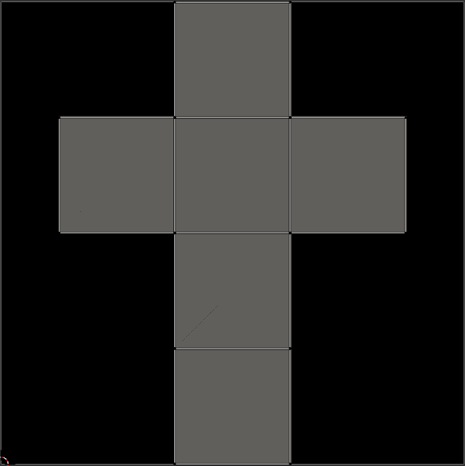
Textures: Terrain
The textures for the terrains are made to be simple. The grass texture is a light green, which it was then given a small metallic coat and sheen tint to give it a small shine, to emulate wet grass shining. The Water is a baby blue with some light cyan to add some depth to the water. The savannah is just a base colour then its given small squares with to corners dragged inwards to give it a jagged look

Slide 9
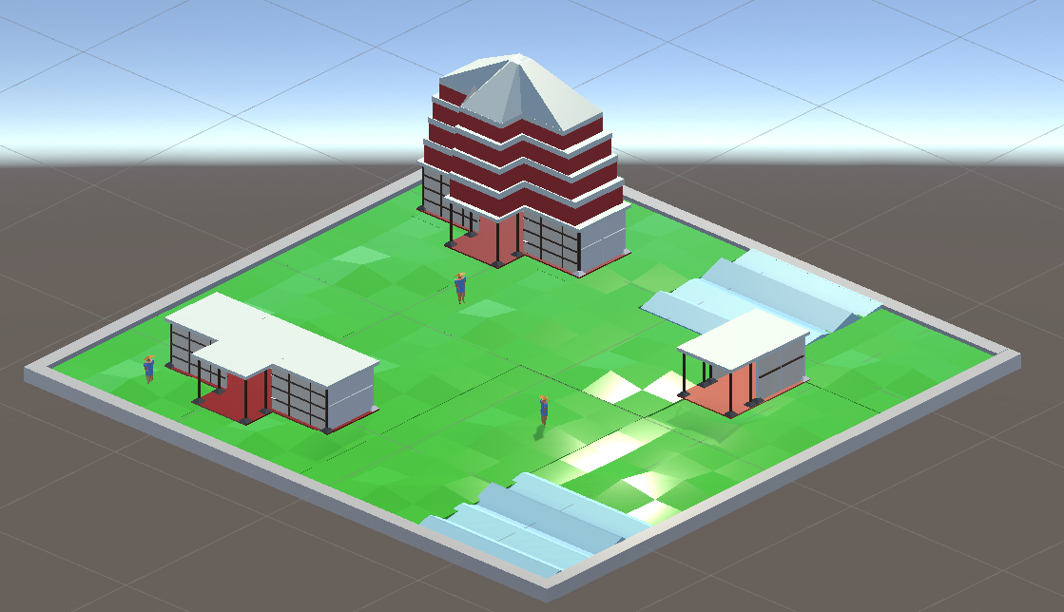
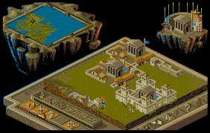
Level Design: Level 1
This is the Grassland level design for LVL 1, It features small mounded grass and some water spaces to stop construction like in the original. Each tier of building is present and the basic farmer NPC. It also features the boarder around the map like the original

Slide 10
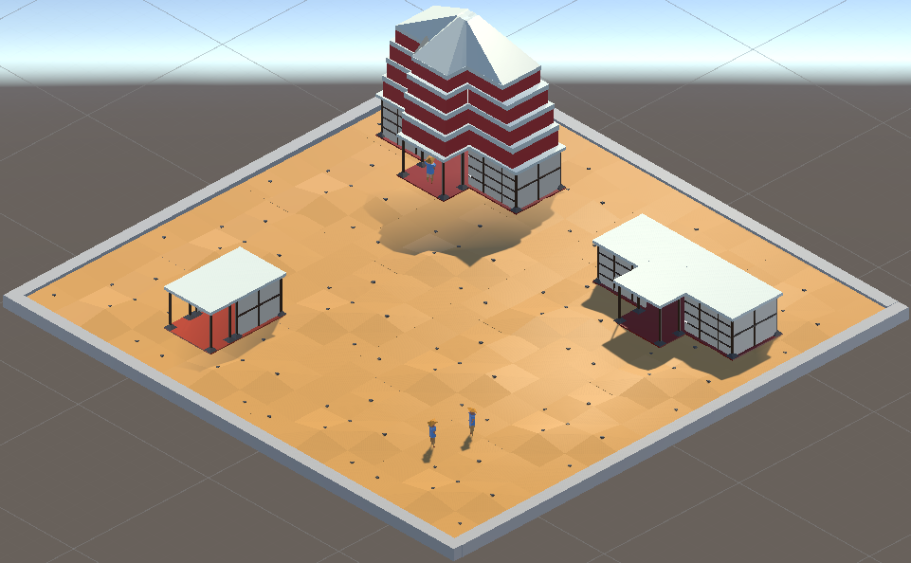
Level Design: Level 2
This is the Savannah level design for LVL 2, It features small sand mounds and jagged stones to give the enviroment more life. Similarly, to the other level each tier of building is present and the basic farmer NPC. It also features the boarder around the map like the original

Slide 11

Audio:
For audio I have developed:
A small theme song that would play when the player would open to the main menu. The audio is only 20sec long, but it would loop
A failure sound effect that plays when the player tries to do something they can’t do, For example in populus you can terraform land if the player tries to terra form land not connected to any of their kingdom this noise will play subtly telling the player they can’t
A success sound affect for when a building evolves too the next stage. The original game is void of noise only having a low bass playing in the background, so implementing a noise for when a building evolves give the game some life
A Kill and Death noise for when the players followers fight the followers of another enemy god
Menu Music
Death Sfx
Fail Sfx
Kill Sfx
Success Sfx
Metal Clash Sfx

